Slide 1

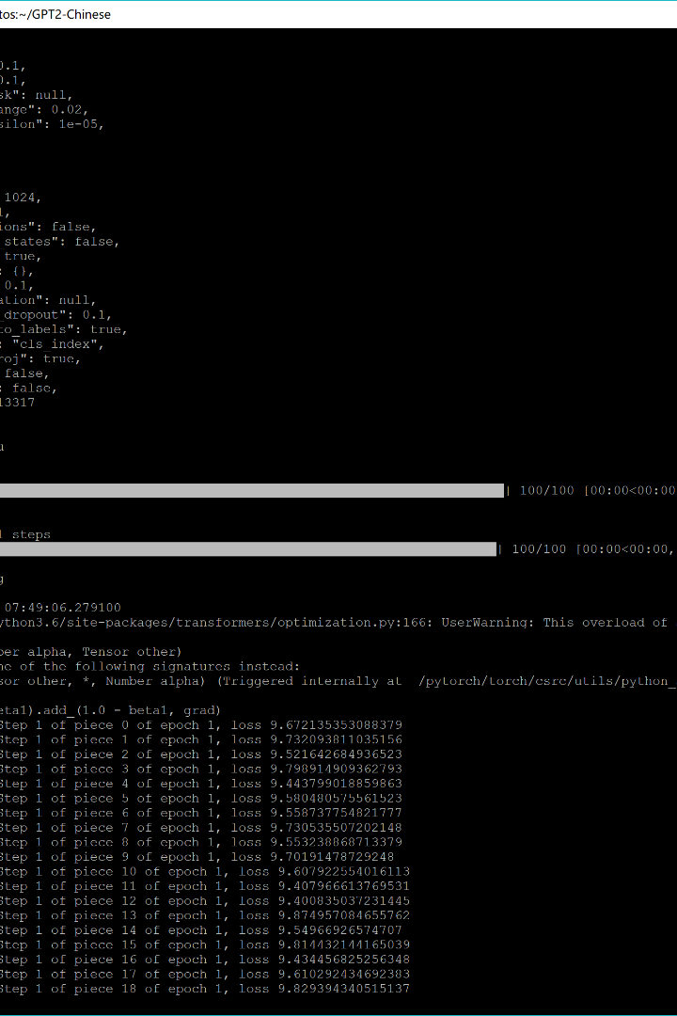

The Different Versions of the GPT Model
The GPT model is the most advanced language generation algorithm out there, but the versions available differ in several aspects. This presentation covers the essential details of each version of GPT.

Slide 2

GPT-2 Architecture and Capabilities
Parameters
Capabilities
GPT-2 has 1.5 billion parameters
Impressive language generation across various tasks

Slide 3

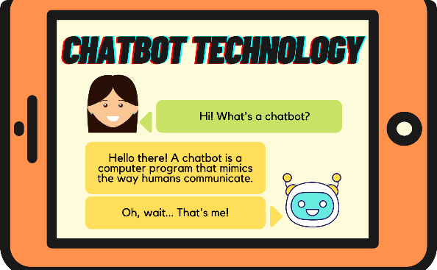
ChatGPT: A Fine-Tuned Variant of GPT-2 for Chat
Purpose
Application
Designed specifically for chat-based interactions and conversations
OpenAI made it available as a research preview that could understand and generate responses in a conversational manner

Slide 4

The Scale of GPT-3 and its Capabilities
1
Parameters
GPT-3 is one of the largest language models, with 175 billion parameters
2
Capabilities
GPT-3 demonstrated significant improvements over GPT-2, showcasing remarkable natural language understanding and generation across a wide range of tasks. It could be adapted for various applications, including chatbots

Slide 5

ChatGPT Fine-Tuned to be Based on GPT-3
1
Architecture
2
Fine-Tuning
ChatGPT is based on GPT-3 with the same architecture and capabilities inherited from GPT-3
OpenAI fine-tuned GPT-3's based version for chat-based interactions, allowing users to hold conversations with this model

Slide 6
GPT-3.5 Turbo: A Specialized Variation
Variation
Optimization
GPT-3.5 Turbo is another variant of the GPT-3 model
It is designed for lower-latency applications, optimizing for faster response times, making it suitable for real-time interactions where minimizing response delays is crucial

Slide 7
Factors Contributing to Differences in GPT Models
Model Size
Training Data
Fine-Tuning
Optimizations
Apart from model architecture, several other factors contribute to the differences between the GPT models mentioned above. These include model size, training data, fine-tuning, and specific optimizations for performance improvements...

Slide 8

ChatGPT and Creating Instances of itself
ChatGPT and other language models like it are not equipped to generate or comprehend instructions for creating another instance of the GPT model. While they can operate on the patterns and information present in their training data, these models lack the ability to create specific instructions or code for building similar models. That level of abstraction and knowledge isn't feasible with current language models...

Slide 9
Elon Musk's Grok Chatbot
Background
Capabilities
Development
Elon Musk is shifting the focus of OpenAI to Tesla, and he's challenging ChatGPT with his own AI chatbot named Grok
Based on data from Twitter (now called X), Grok can already outperform ChatGPT 3.5 across several benchmarks and has a sense of humor to bring some fun into the AI arena.
The first product of Musk's xAI company was developed in two months. It intends to work closely with Tesla, X, and other businesses.

Slide 10
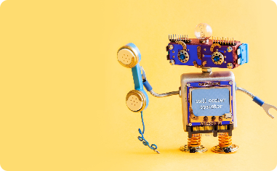

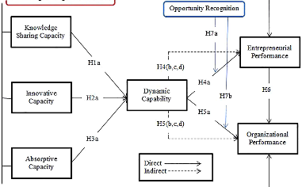
The Future of AI Chatbots
AI-Assisted Conversations
Virtual Assistants
AI Knowledge and Business Monitoring Platforms
AI is slowly invading customer service operations, through virtual assistants that interact with customers in different languages and cultures
AI chatbots powering routine conversations with humans in business
AI is also changing the way businesses monitor and understand their customers' demands in real-time

Slide 11
Conclusions
The GPT model and its many variations have already transformed language generation extensively. As we have learned, each version of the GPT model differs in terms of architecture, scale, and specific use cases. The primary purpose of language models such as Chatbot GPT or Grok is to understand and generate human-like text based on the input they receive. AI continues to evolve through various applications, and we believe there is still a lot yet to come...

